Slide 1
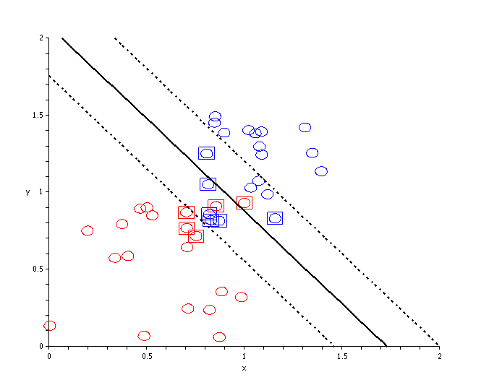
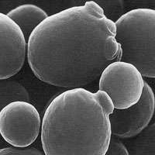
Predicting Novel Candidate Genes Associated with Longevity in Saccharomyces cerevisiae using Support Vector Machine.
Presenter: Corin V. White
Advisor: Dr. Hong Qin
Location of Research: Amgen lab, Science Center, Spelman College, Atlanta, GA 30314
http://home.in.tum.de/~stibor/svm_maple/images/C-SVM-demo_2.gif
http://scienceblogs.com/oscillator/saccharomyces.jpg

Slide 2
Outline of Presentation
Introduction
Previous Findings
Aging & Yeast
Purpose of Study
Computational Methods
SVM & R programming
Results
Predicted Genes
Conclusions
http://scienceblogs.com/oscillator/saccharomyces.jpg

Slide 3
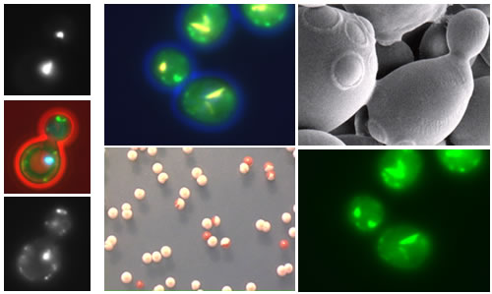
S. cerevisiae (Yeast) & Previous Findings
Yeast is an excellent model system.
Small genome
Short generation time
Cellular aging is similar in yeast and humans.
Many genes have been associated with life span in yeast.
Example: TOR1( Kaeberlein, et. al., 1999 & 2005; Fabrizio et. al., 2001)
The rate of aging is proportional to robustness in yeast. (unpublished data, Qin lab)
Life span is directly related to fitness. (unpublished data, Qin lab)
http://www.bio.davidson.edu/courses/genomics/2004/Bossie/yeastimages.jpg
Notes:
Characteristics of aging that are similar included the slowing down of cell proliferation. Robustness is a measure of ability to sustain environmental changes. Fitness is a measure of reduction in relative growth rate in response to mutations in certain genes. Correspondingly, life span is directly related to fitness since the more fit an organism is the longer organism will survive. We also found that the number of protein interactions, a property of protein networks, is not correlated with life span which is one of the reasons we chose to focus primarily on genomic features. As, previously stated, many genes have been associated with life span regulation in yeast. TORI encodes a protein kinase that regulates growth by regulating meiosis, translation and transcription. More specifically, homologous genes in yeast and nematodes have been found such as CDC 42 and 33 which code for proteins that regulate the cell cycle.

Slide 4
Hypothesis & Aim
http://scienceblogs.com/oscillator/saccharomyces.jpg
Hypothesis: Aging is a system-level property of gene/protein networks.
Genetic components of this network should be significantly involved in the regulation of RLS.
Genes have genomic features
Evolutionary distance
Morphology
Expression
Fitness
Replicative life span(RLS)
Aim: To determine if genomic features can be used to predict aging in yeast.
Support Vector Machine (SVM).
Notes:
We hypothesize that aging is a systematic-level property of gene networks. However, studies have found that protein interactions and protein networks are not really correlated with life span regulation. However, as stated before specific genes have been correlated with life span. Evolution distance is the number of substitutions that have taken place since the fugal-animal split. Morphology data is phenotypical data based on genetic mutations. Expression data is the total mRNA expression in a yeast cell. Fitness is a measure of how “fit” an individual is based on susceptibility to genetic mutation. RLS data is based on measures of life span in response to gene expression.

Slide 5
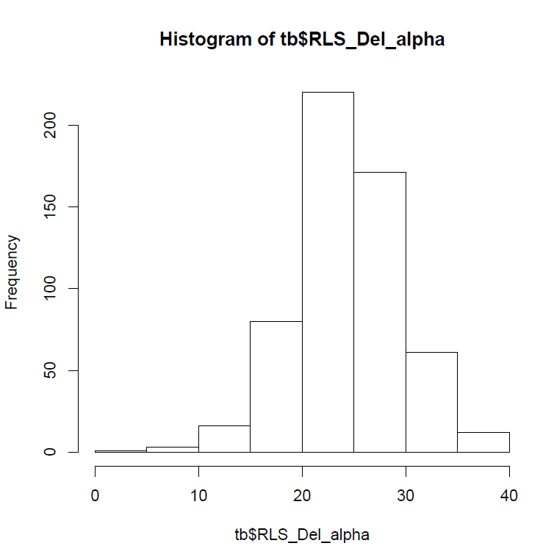
Methods: Data Selection & Analysis
Histogram of Replicative Lifespan
Gathered data sets
Expression
Morphology
Replicative life span(RLS)
Evolutionary Distance
Fitness
Normalization
Data Fitting & Scaling
Converted genomic features
Principal Component Analysis (PCA)
Chose appropriate data
Expression data were not utilized
RLS data were divided into classes
Train Support Vector Machine (SVM)
Frequency
Neutral
Short
Long
Replicative Lifespan (RLS)
Notes:
Only morphology and RLS data were used because significant results were not produced when using the expression data. This is histogram shows the distribution of RLS. The x-axis is the number of cell divisions and the y-axis is how frequent those divisions occurred. To make our prediction more accurate, only the top 20% were long, middle 30% neutral and bottom 20% short.

Slide 6
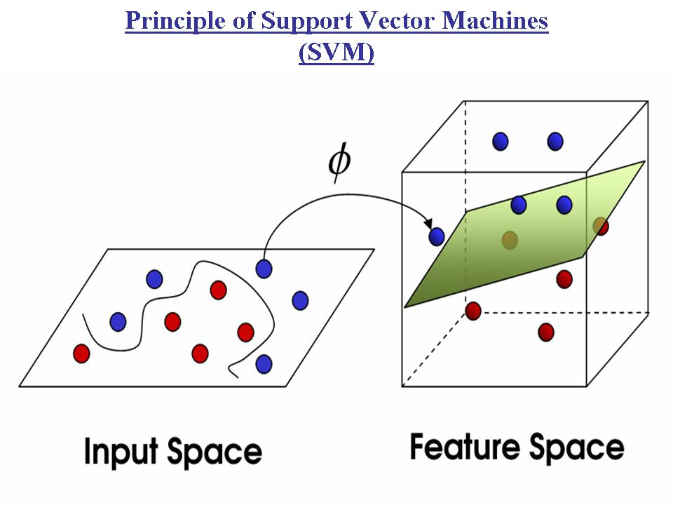
Methods: Support Vector Machine (SVM) Basics
Classification tool
Used when categories involve complex components
Determines linear hyperplane that separates data
Learning algorithm
Contains parameters (ɤ and C) and a kernel function
Based on libsvm software with R interface
Evolutionary Distances & Fitness
* 2675 gene pair interactions.
Novel Predicted genes
Kernel function
Life Span Data
* 561 genes classified as “long”, “short” or “neutral”
Support Vector Machine (SVM)
*Set parameters
Figure1: Pictorial Representation of SVM training data sets and SVM results. Four different data sets were combined and put into support vector machine (SVM) to allow the prediction of novel genes.
Morphology Data
* Mutant genotypes with different phenotypic characteristics.
http://www.imtech.res.in/raghava/rbpred/svm.jpg
Notes:
Interface: A point of interaction between two systems: ie. Packages e1071 and pcurve. LIBSVM Library for Support Vector Machines is a software which is a C++ software that was used with e1071 and pcurve packages in an R interface.

Slide 7
Results: SVM
46 novel genes were found to be associated with a long life span
These genes are varied
Many pathways are unknown or have not been associated with aging.
Novel candidates include genes in known pathways associated with aging.
Chaperone
Ribosomal Machinery
Chromosomal Silencing
Cell Cycle
Common Name | Systematic Name | Documented Function
UMP1 | YBR173C | Protein catabolism chaperone activity *proteasome core complex
UBX7 | YBR273C | Biological and molecular function unknown*localized to endoplasmic reticulum
NKP1 | YDR383C | Biological and molecular function unknown*localized to kinetochore
CBS1 | YDL069C | Protein biosynthesis translation factor activity* mitochondrial inner membrane.
RPP1A | YDL081C | Protein biosynthesis*structural constituent of ribosome cytosolic large ribosomal subunit
TPS2 | YDR074W | Response to stress* trehalose-phosphatase activity
SCS2 | YER120W | Chromatin silencing at telomere*protein binding endoplasmic reticulum
ARC1 | YGL105W | tRNA-nucleus export*tRNA binding cytoplasm
PIH1 | YHR034C | Protein biosynthesis, molecular function unknown *cytoplasm
RFM1 | YOR279C | Transcriptional gene silencing chaperone activity*nucleus
HIR3 | YJR140C | Transcription in mitotic cell cycle transcription co-repressor

Slide 8
Evaluation of SVM Based on Training Data
 | Long lifespan (Experimental Data) | Not Long lifespan (Experimental Data)
Long lifespan (SVM Prediction) | 46 True positive | 2 False positive
Not long lifespan (SVM Prediction) | 64 False negative | 269 True negative
SVM Evaluation
True = Agreed with experimental data
False = Did not agree with experimental data
Positive= Genes associated with long life span
Negative= Genes associated with non-long life span
True positives are genes accurately predicted to be associated with long life span.
False positives are genes that were expected to be associated with non-long lifespan but were not.
This rate is significant (4.2%).
False negatives are genes that were expected to be associated with long life span but were not.
True negatives are negative results that agreed with experimental data.
Notes:
Again we were only interested in genes with long lifespan since we are trying to gain insight on cellular aging. True= prediction was true. False= prediction was false. This table shows the true accuracy of our SVM prediction. The null hypothesis is on the top while the alternative hypothesis is on the bottom. Positives that are highlighted in red are genes that SVM predicted to be associated with long life span. Negatives are the genes that were not predicted by SVM to be associated with long life span and thus are negative. The true positive rate is our key result since our prediction was correct for 46 genes. The false positive rate is 4.3% and represents the likelihood we rejected our null hypothesis in error. The false negative rate is inversely related to the false positive rate. False negative is the proportion of negative test stats that are really positive events in a sense that SVM related them to life span.

Slide 9
Conclusions & Future Work
http://scienceblogs.com/oscillator/saccharomyces.jpg
Conclusions:
SVM is a useful tool in the prediction of novel genes associated with lifespan.
46 genes were predicted with a 4.2% false positive rate.
Future work includes:
Adjusting SVM parameters
Using a similar approach to predict novel genes in other organisms.
Notes:
SIR2 in the prediction genes is in Drosphilia and C. elegans and has been associated with life span regulation. Overexpression in yeast results in a 30% in lifespan.

Slide 10



Acknowledgements
Dr. Hong Qin, Spelman College
Members of the Qin Lab/Proteomics Class.
Nation Science Institute of Health (NIH)- National Center for Minority Health and Health Disparities (NCMHD) Grant for Spelman College Center for Health Disparities Research and Education (CHDRE).
Spelman Research Day Staff & Faculty
References
Bahar, R., Hartmann, C.H., Rodriguez, K.A., Denny, A.D., Busuttil, R.A., Dolle, M.E., Calder, R.B., Chisholm, G.B., Pollock, B.H., Klein, C.A., Vijg, J. Nature. 2006. 441:1011-1014.
Boehm, M., Slack, F. Science 2005, 310 (1954).
Fabrizio, P.,Pozza, F., Pletcher, S.D., Gendron, C.M., & Longo, V.D. Science. 2001. 292(5515):288-290
Finch, C.E., Ruvkun, G. Annu. Rev. Genomics Hum. Genet. 2001. 2:435.
Golden, T.R., Hubbard, A., Dando, C., Herren, M.A., Melov, S. Aging Cell, 2008. 7:850-865.
Henderson, K.A. & Gottschling, D.E. Curr Opin Cell Bio. 2008. 20(6):723-728.
Kaeberlein, M., McVey, M. & Guarente, L. Genes Dev. 1999. 13(19): p. 2570-2580.
Kaeberlein, M., Powers, R.W., Steffen, K.K. 3RD, Westman, E.A., Hu, D., Dang, N., Kerr, E.O., Kirkland, K.T., Fields, S. & Kennedy, B.K. Science. 2005. 310(5751):1193-1196.
Kim, S.K. J Exp Biol. 2007. 210:1607-1612.
Mortimer, R.K. & Johnston, J.R. Nature. 1959. 183(4677):1751-1752.
Patterson, G.I.Curr. Biol. 2003, 13:R279.
Stewart, E. & F. Taddei, Bioessays. 2005. 27(9):983.
The Science of Aging Knowledge Environment (SAGE KE), online database, 2006, http://uwaging.org/genesdb/index.php.
Witten, M.T., Bonchev, D. Chem & Biodiversity. 2007. 4:2639-2654.
http://yeast.gi.k.u-tokyo.ac.jp/datamine/download.jsp;jsessionid=C5EBAA3884D4AC58DE10445BC5CD1B5A

Slide 11

Questions???
http://www.vosibilities.com/wp-content/uploads/2009/05/bpm-questions-you-should-ask-your-bpms-vendor1.jpg

Slide 12
SVM VIDEO
Visual of SVM dimensions.
http://www.imtech.res.in/raghava/rbpred/svm.jpg
http://www.youtube.com/watch?v=3liCbRZPrZA

Slide 13
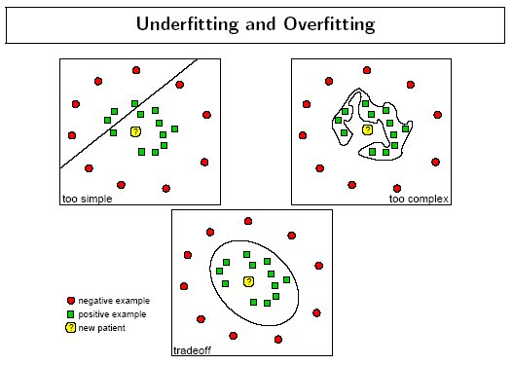
Over fitting &Under fitting with SVM
Big source of error
Margin between the hyperplane and training data should be moderate
Picking the optimal parameters is essential
http://www.dtreg.com/SvmOverfitting.jpg

Slide 14
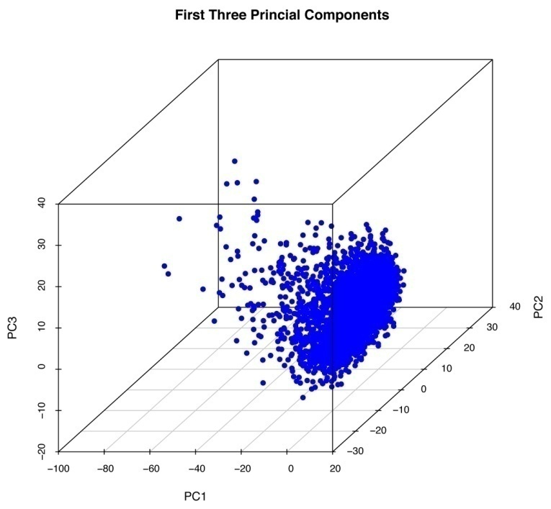
Principle Component Analysis(PCA) Data
Considers each component independent of other data and dimensions.
Change correlated data to uncorrelated data.
Allows the analysis of separate components.
Notes:
PCA allows for the separate consideration and analysis of each variable. Prior to running SVM PCA was done to see if certain genomic features solely correlated with life span and results were varied. The 3D PCA result shows a random cloud with an R² of 0 which means that there is no correlated for the first three components.

